Slide 1

首爾科大 SeoulTech
應外系 林姿妤

Slide 2
TABLE OF CONTENTS
行前準備
01
04
學校活動
金錢的準備
02
05
文化差異
宿舍 & 學餐
03
06
Q & A

Slide 3
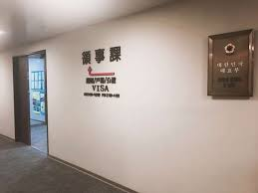
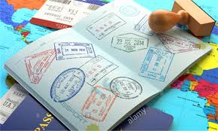
行前準備
1.簽証
2.健康檢查 (TB Screening)
3.保險
4.選課
YOUR LOGO

Slide 4
金錢的準備
韓國帳戶
現金
台幣 + 韓幣
信用卡
金融卡
T-money

Slide 5
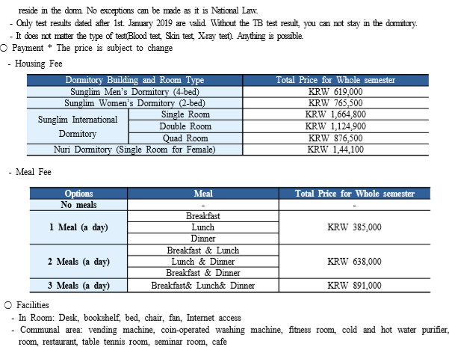
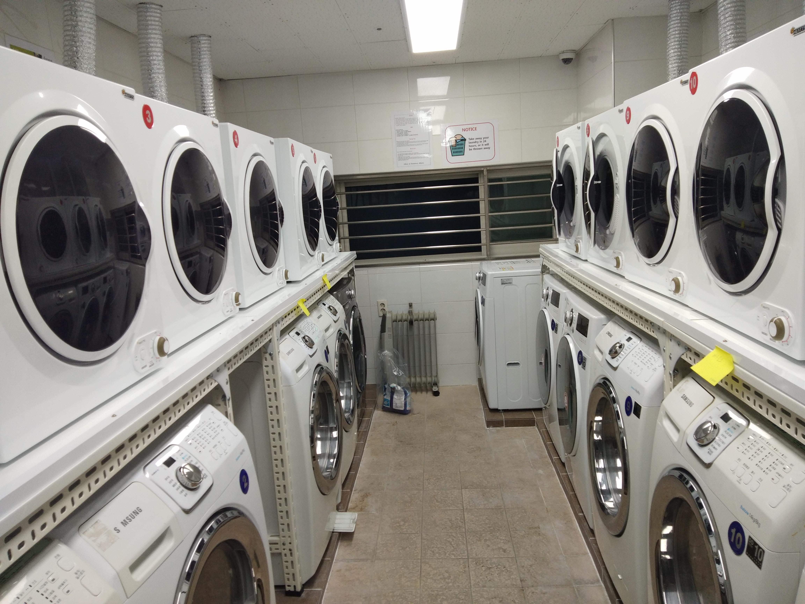
宿舍 & 學餐
NEPTUNE
MARS
Neptune is the farthest planet from the Sun and the fourth-largest in our Solar System. It’s named after the Roman god of the sea
Despite being red, Mars is a cold place, not hot. It’s full of iron oxide dust, which gives the planet its characteristic reddish cast

Slide 6
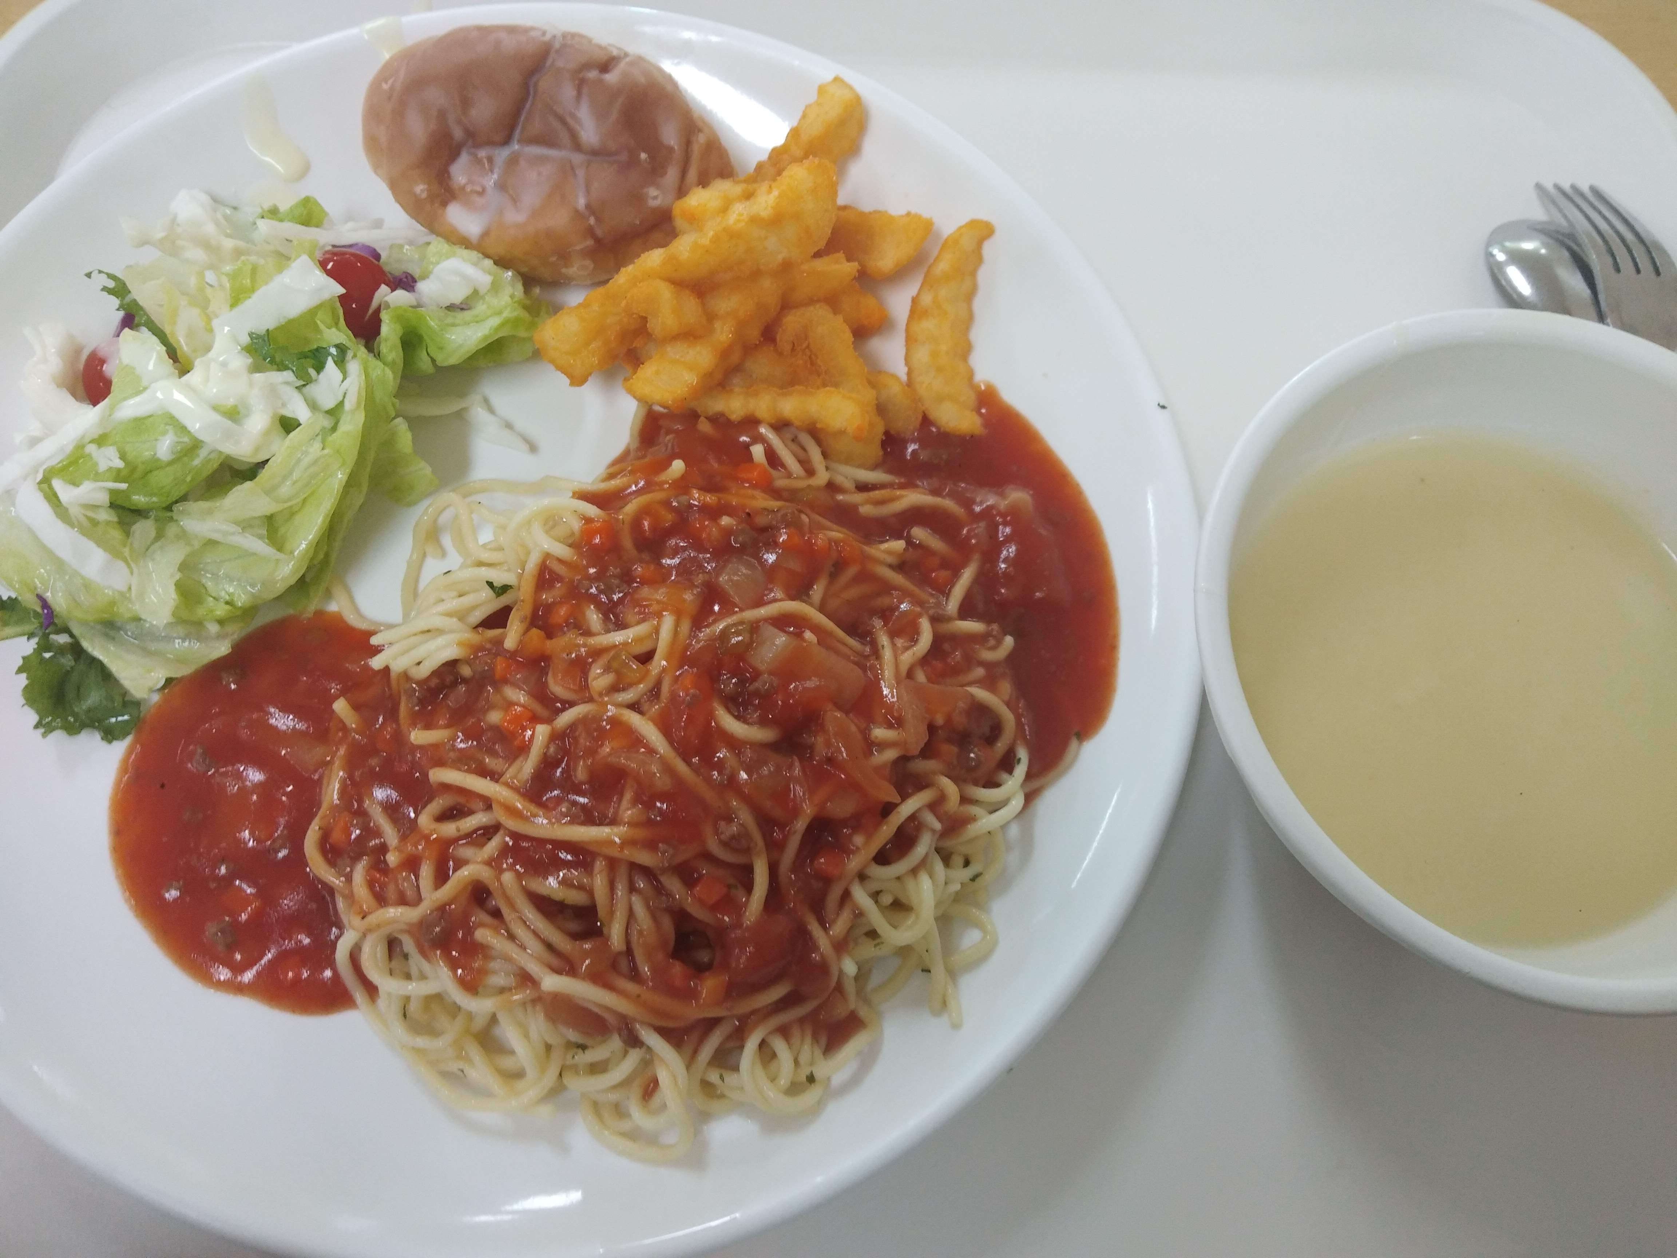
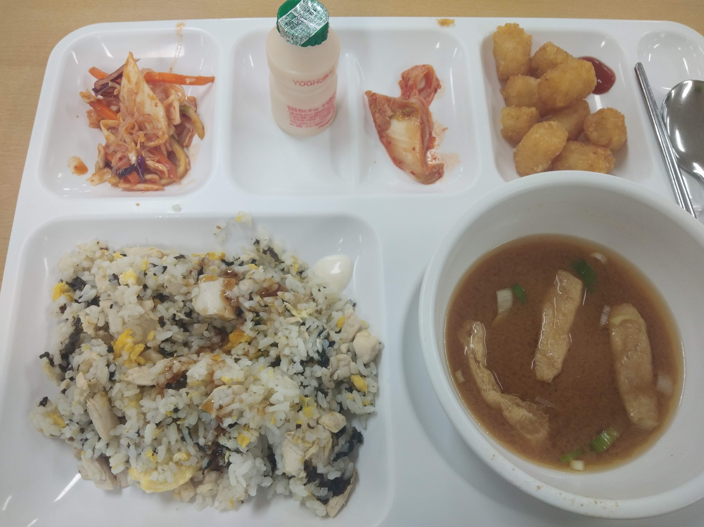

Slide 7
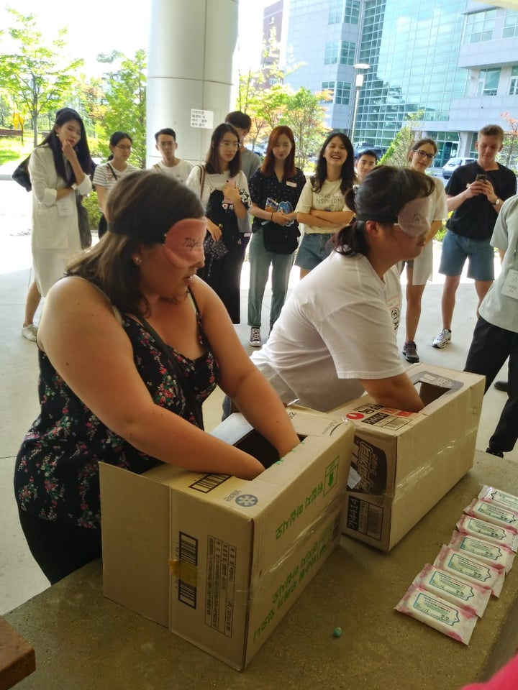
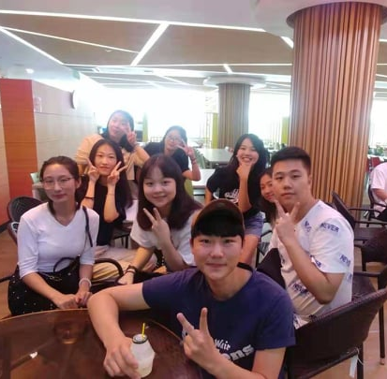
學校活動

Slide 8
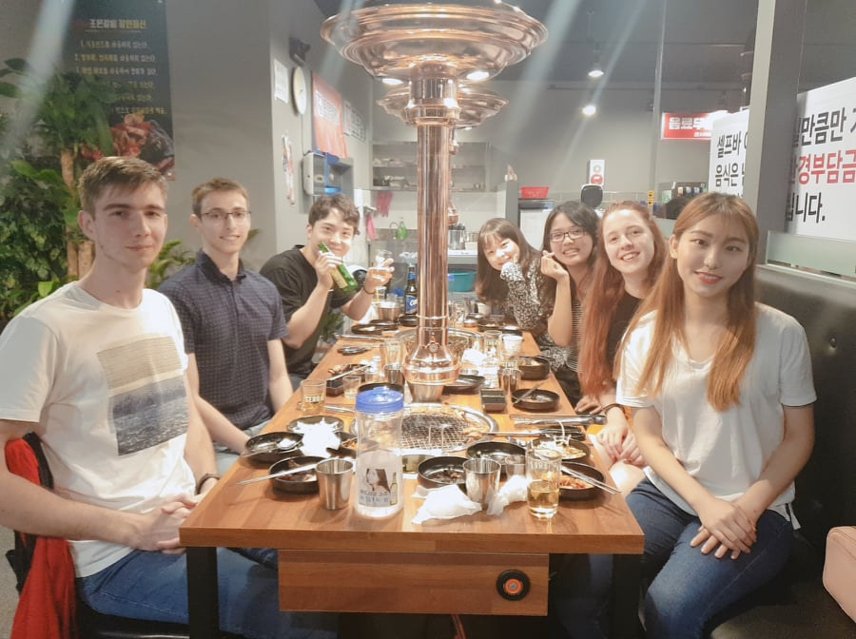
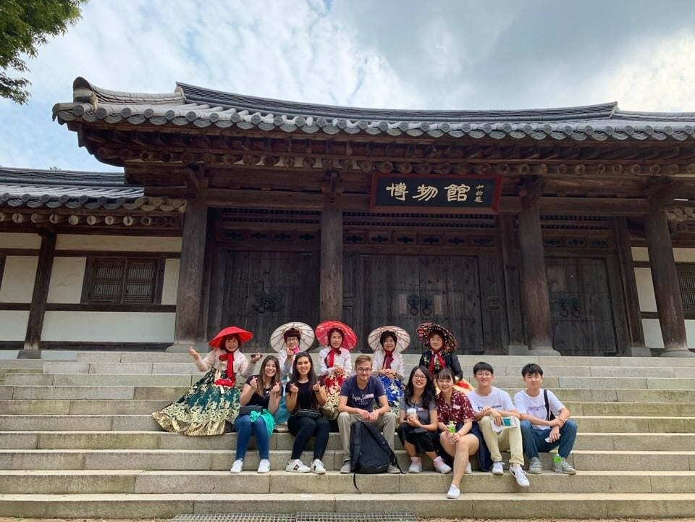

Slide 9
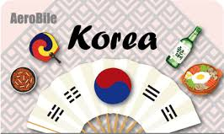
文化差異

Slide 10
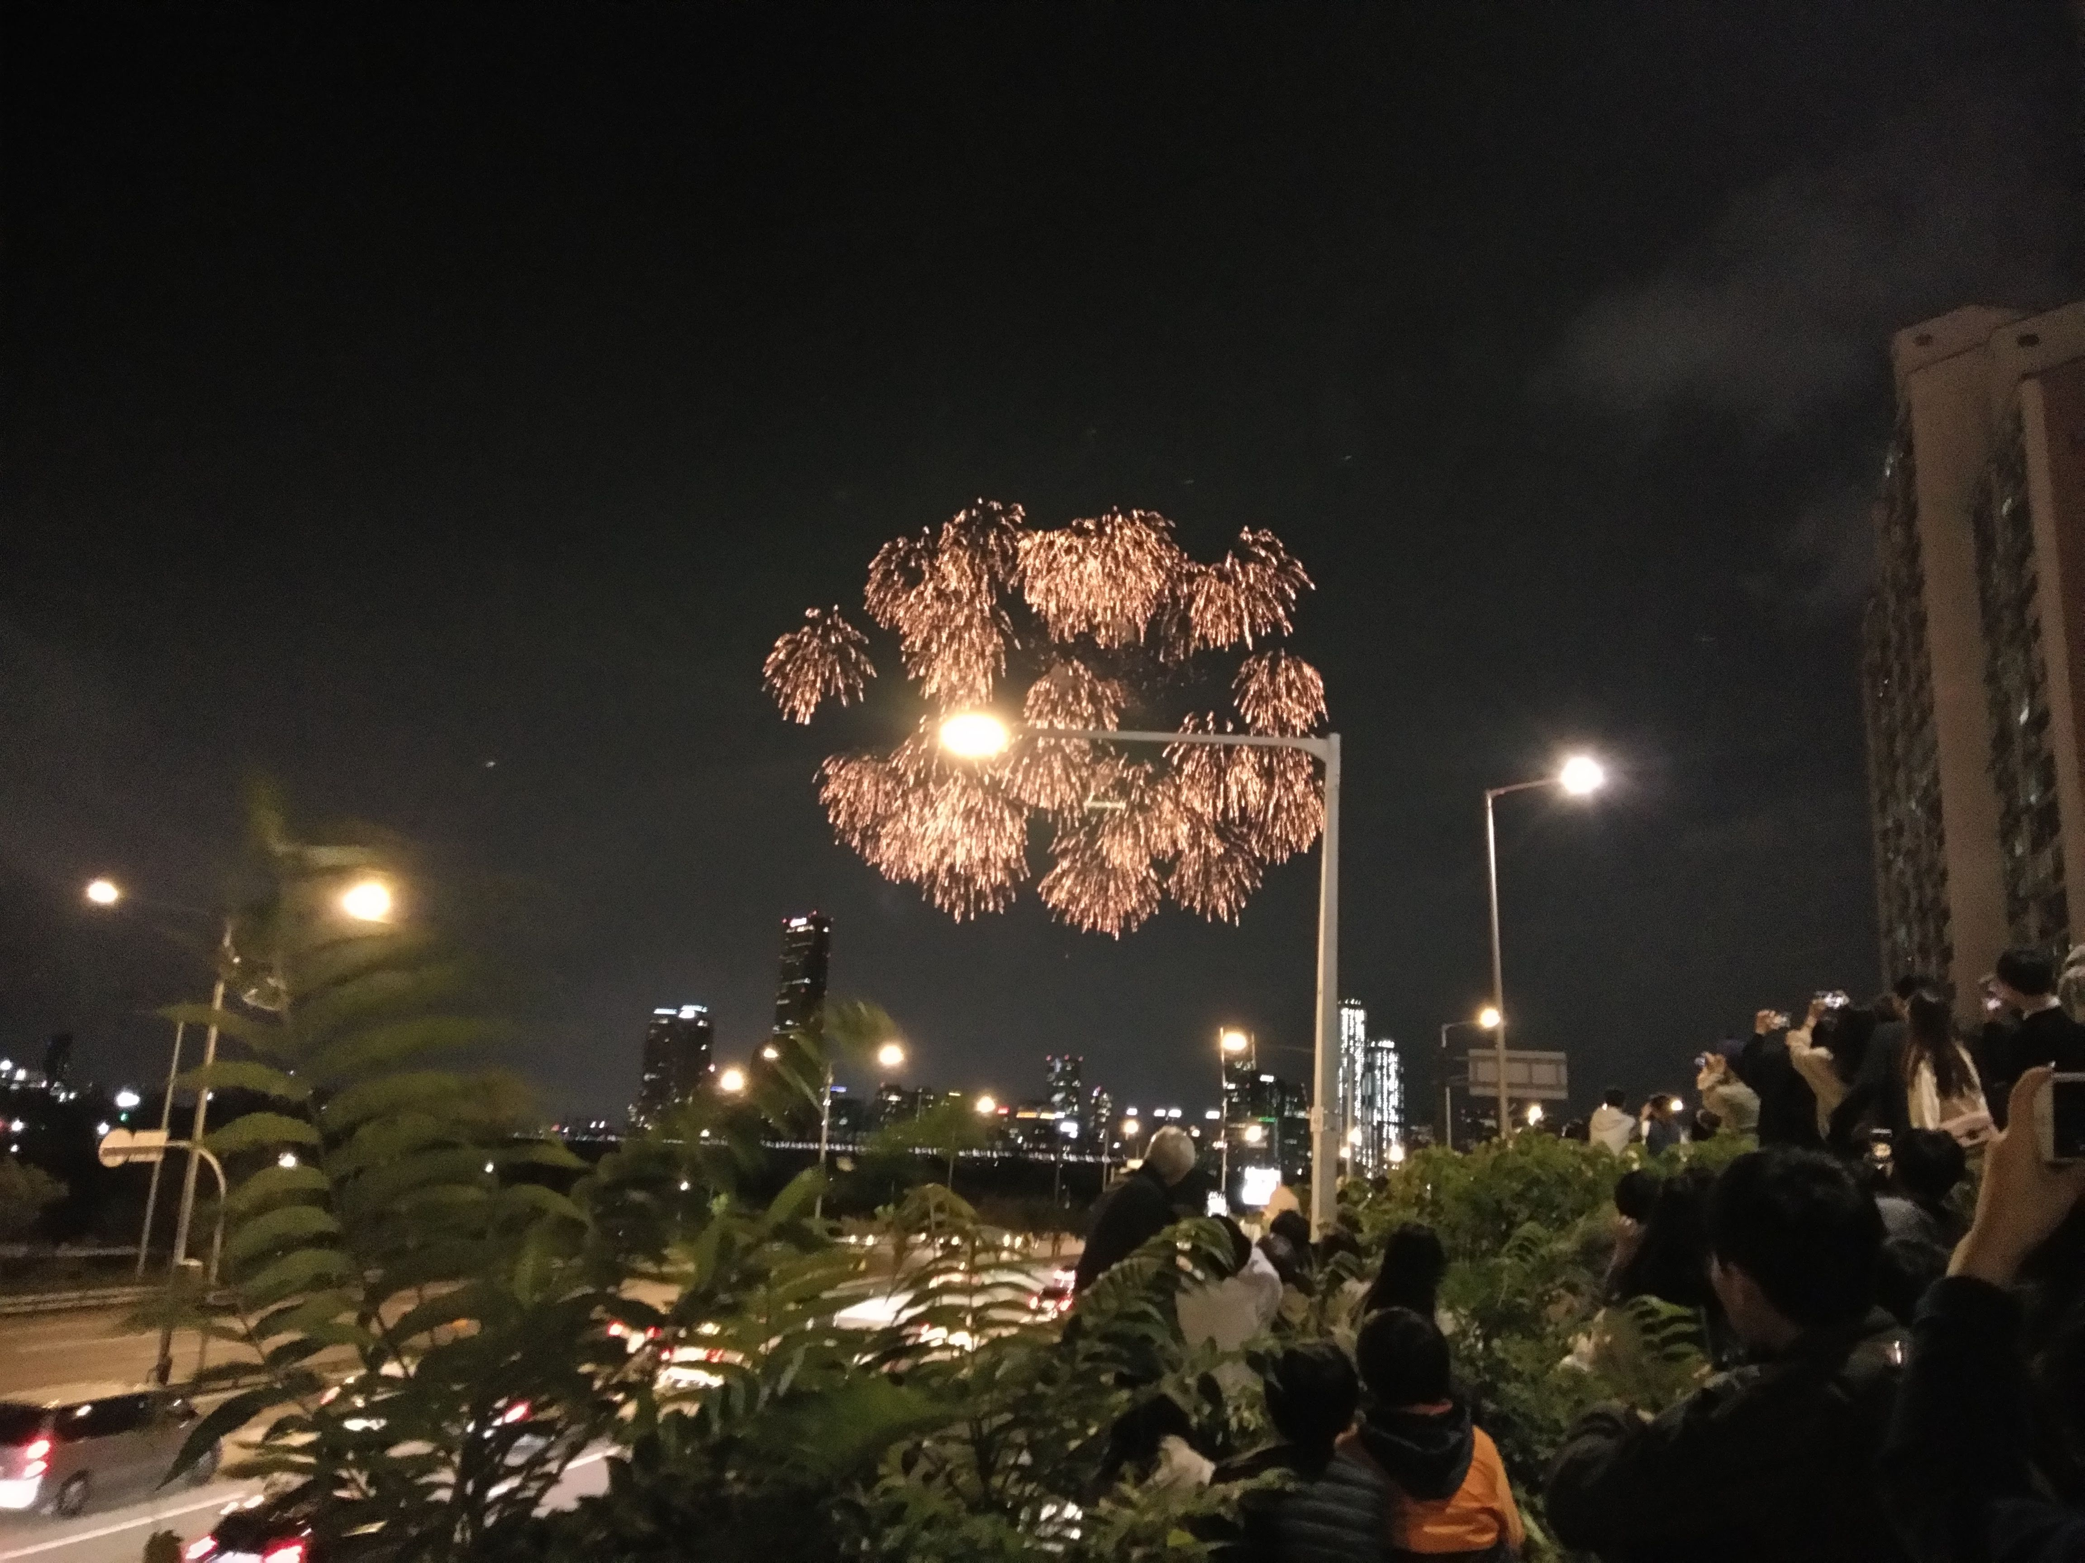
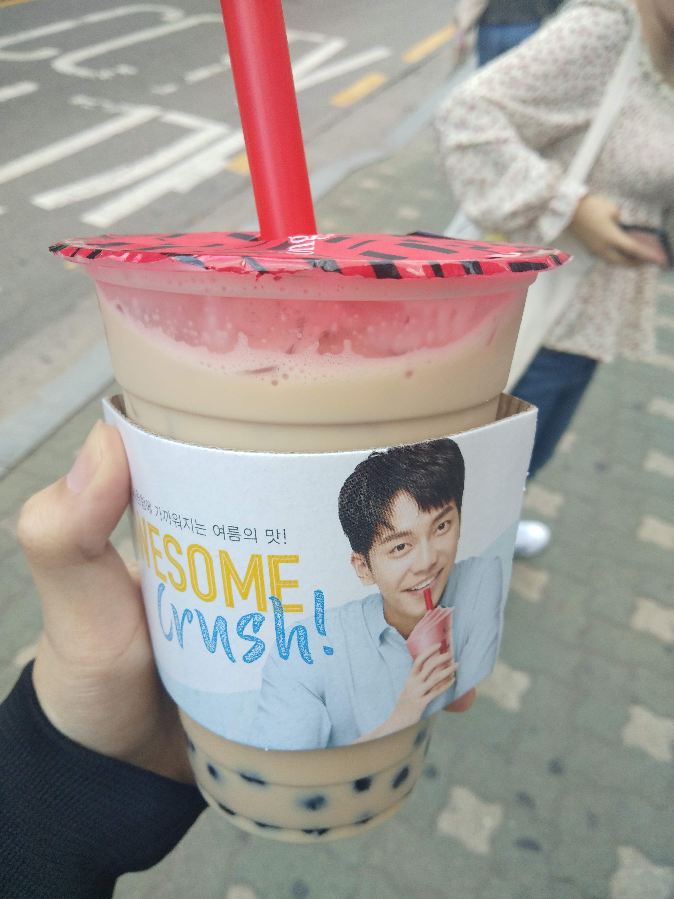
Q & A
Thank you !!

